Slide 1
INTRODUCTION TO
ALGORITHMS
FOURTH EDITION

Slide 2
LECTURE NOTES FOR CHAPTER 24
Maximum Flow

Slide 3
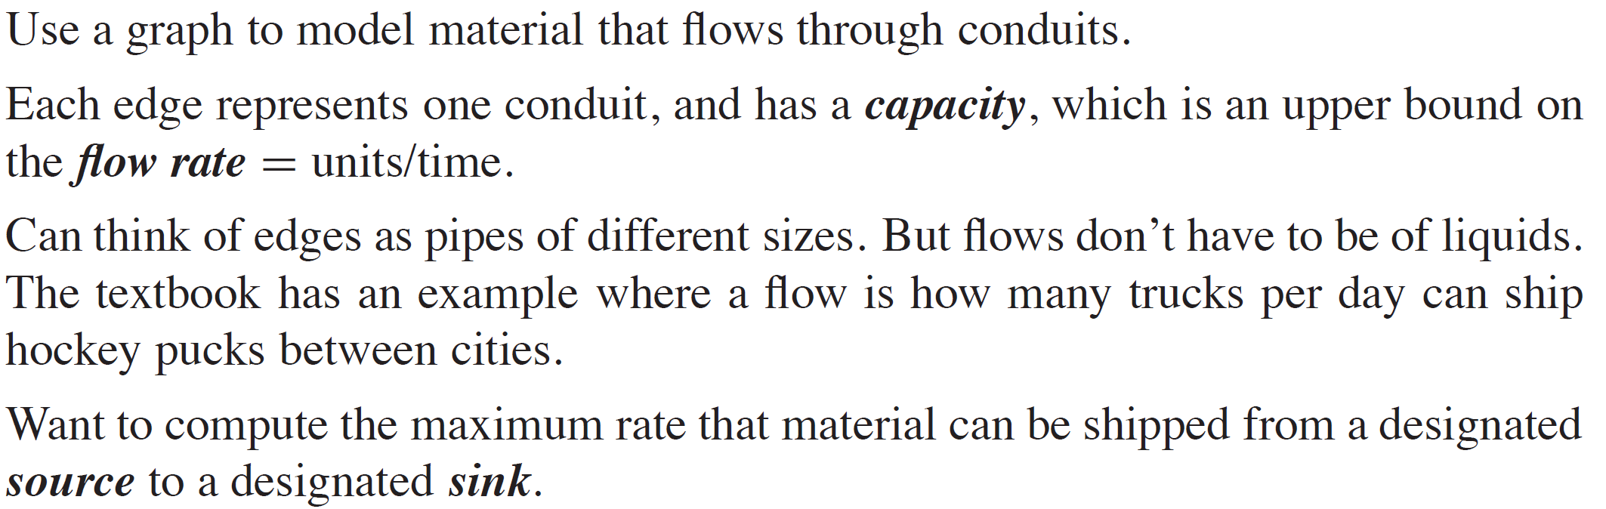
CHAPTER 24 OVERVIEW

Slide 4
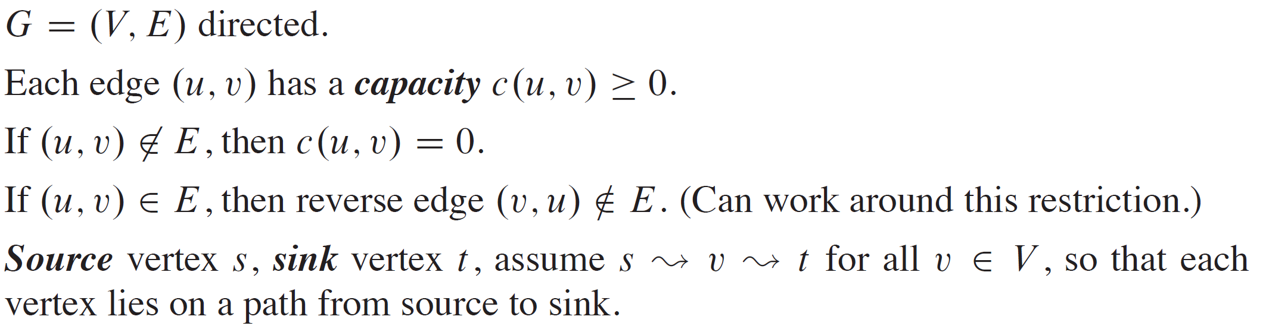
FLOW NETWORKS

Slide 5
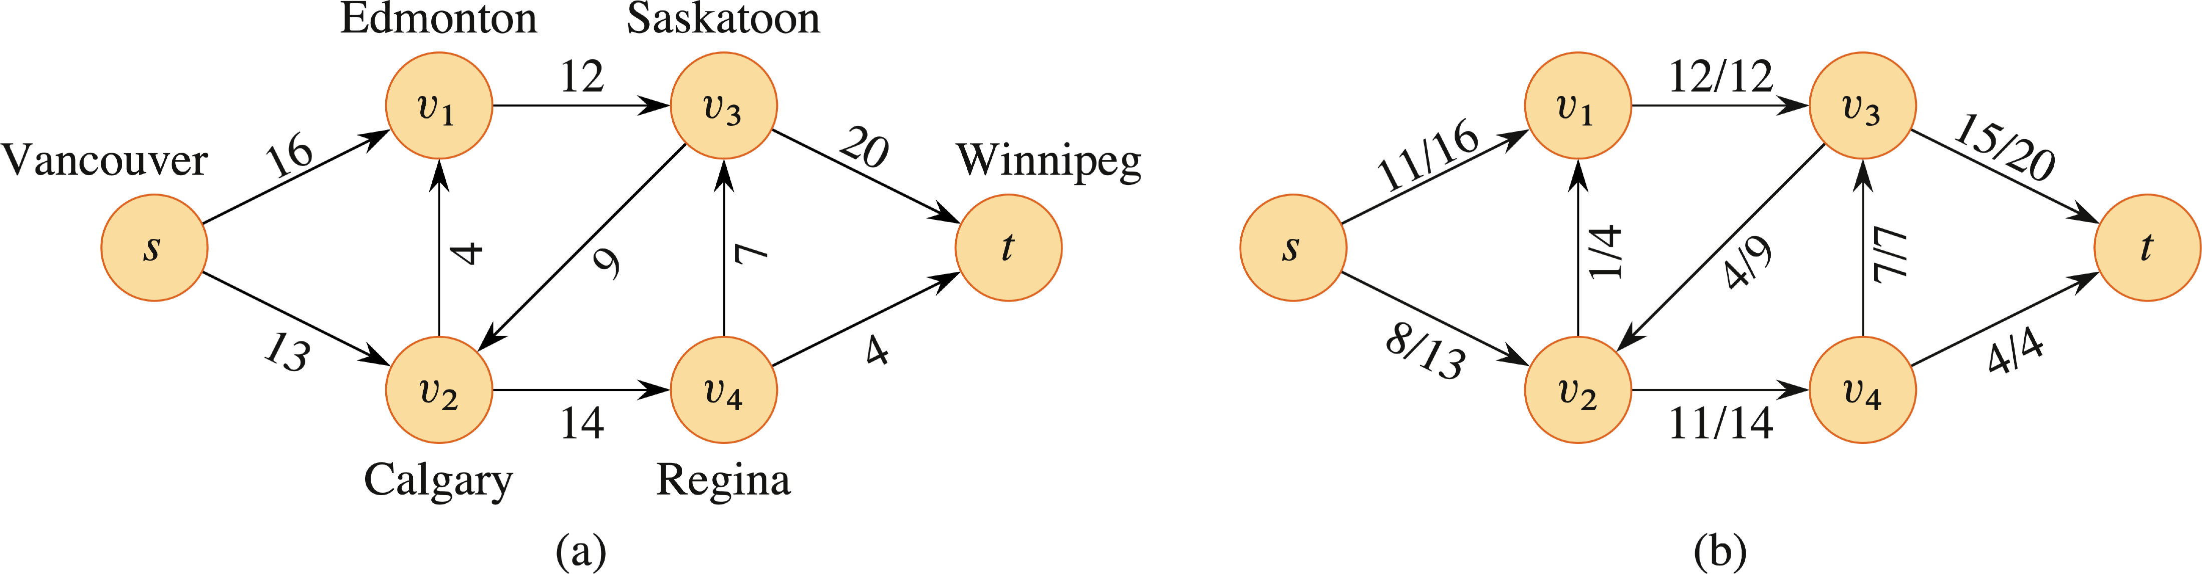
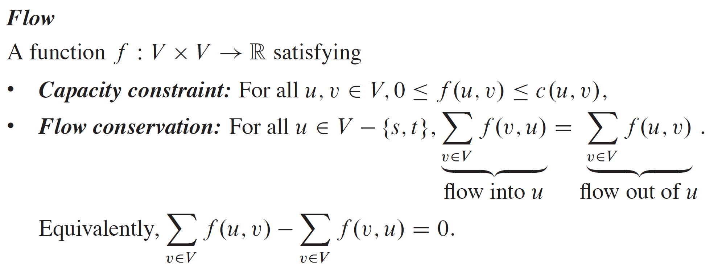
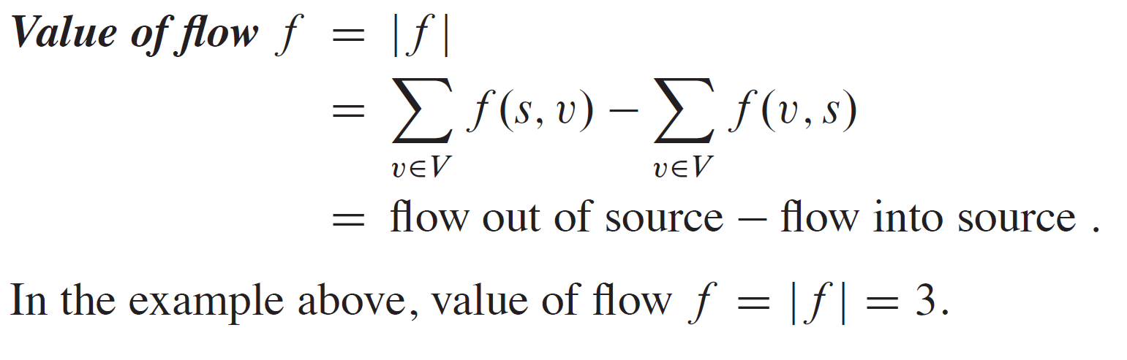
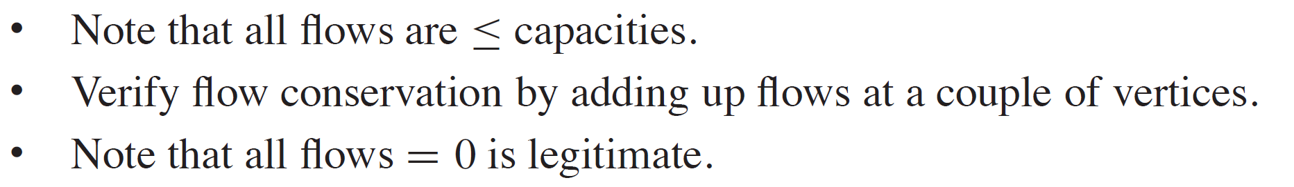
EXAMPLE
WLOG, assume one source, one sink, and edges in at most one direction between any vertex pair.

Slide 6
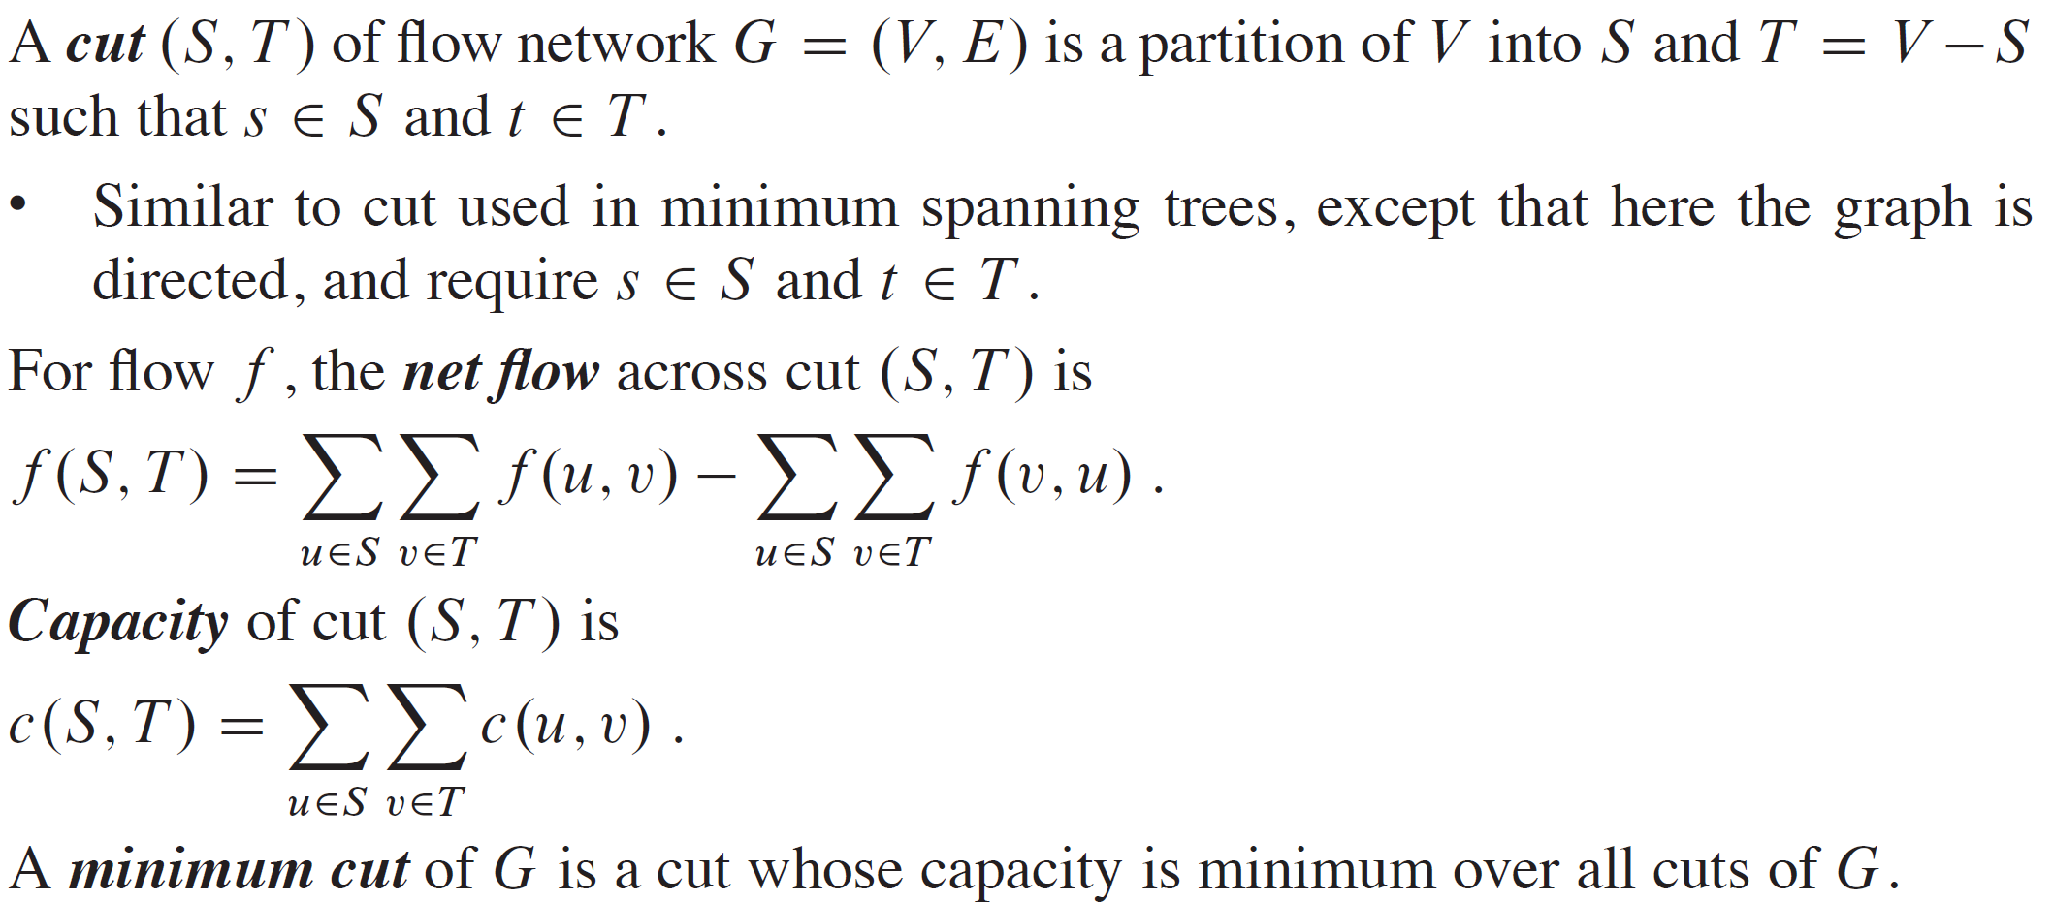
CUTS

Slide 7
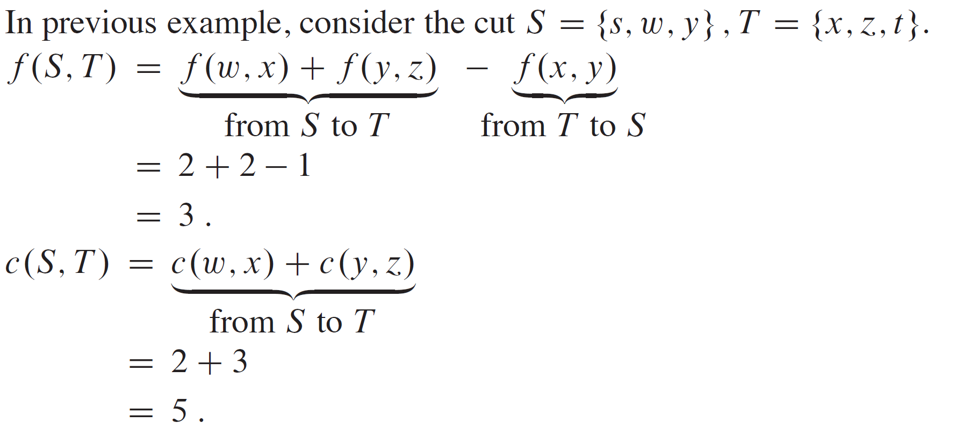
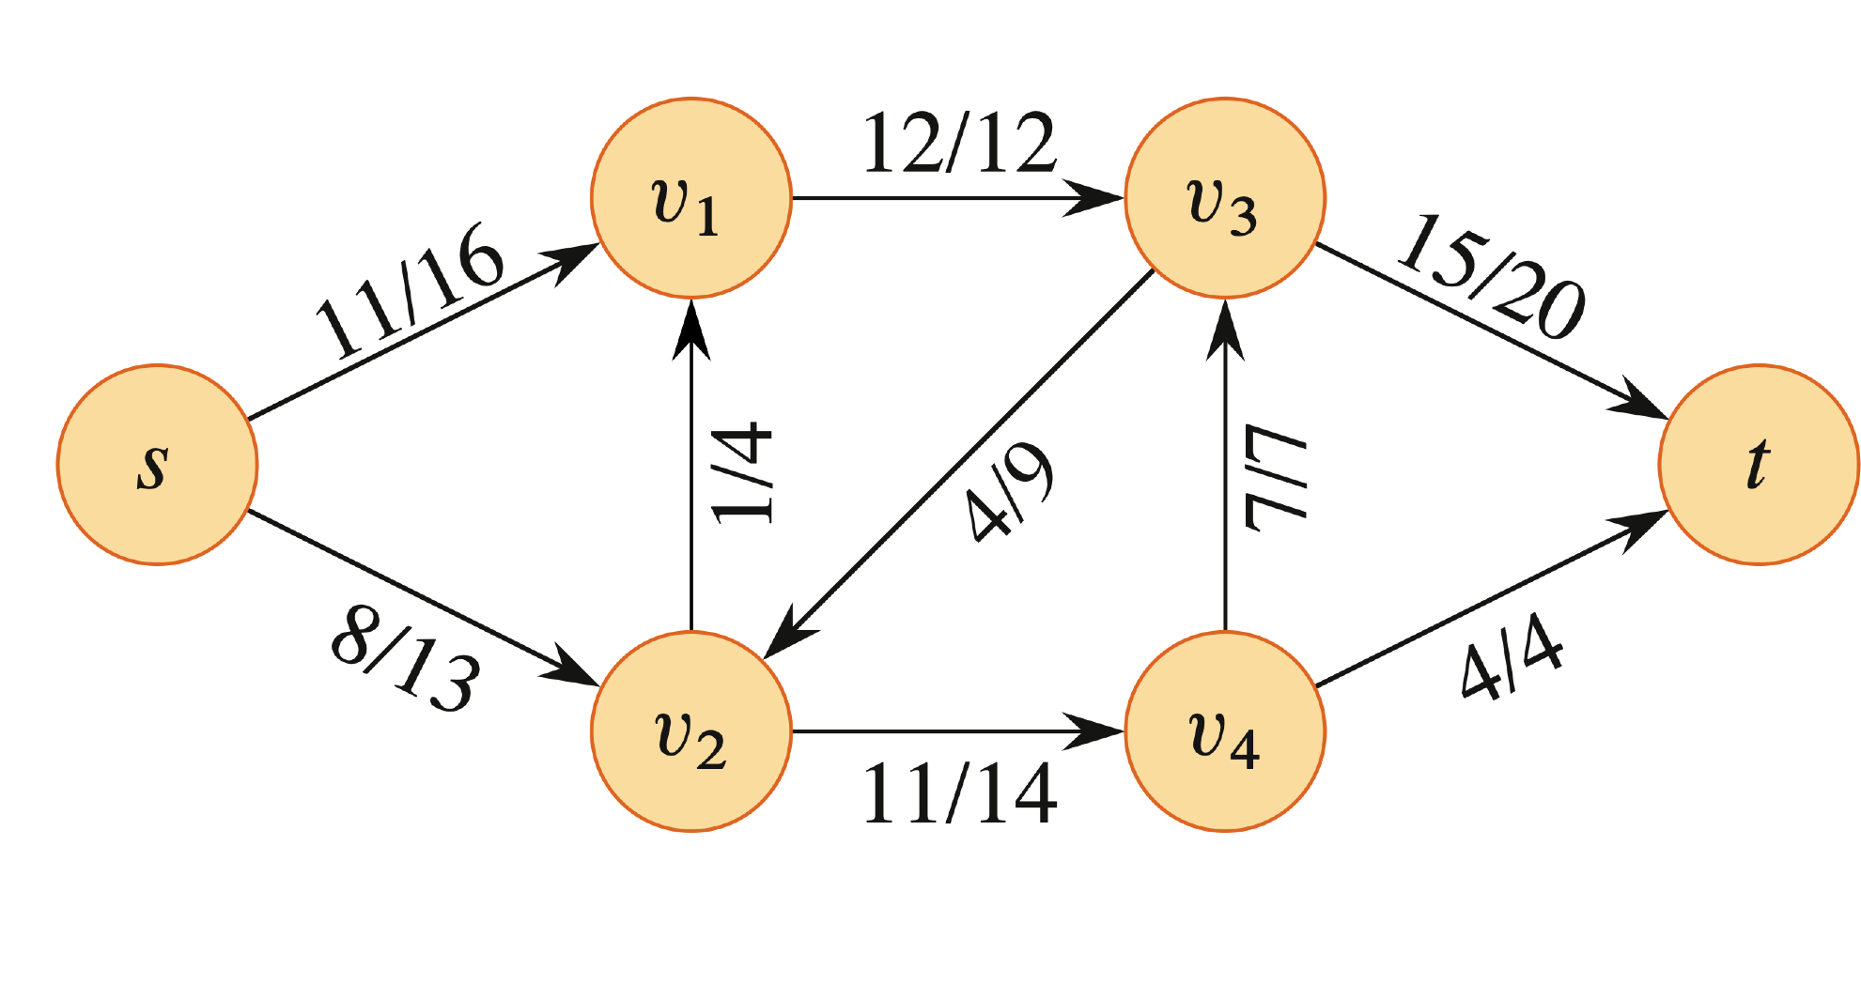
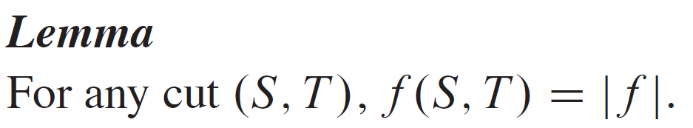
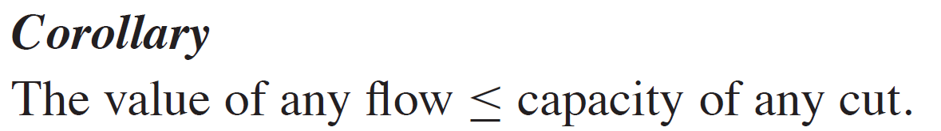
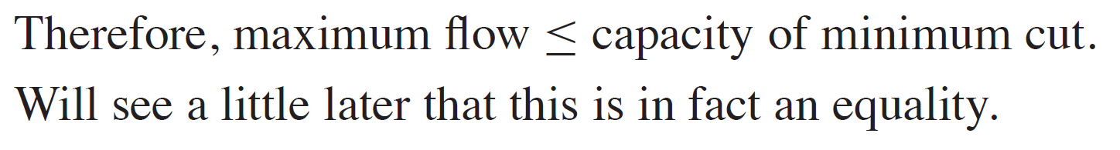
CUTS (continued)

Slide 8
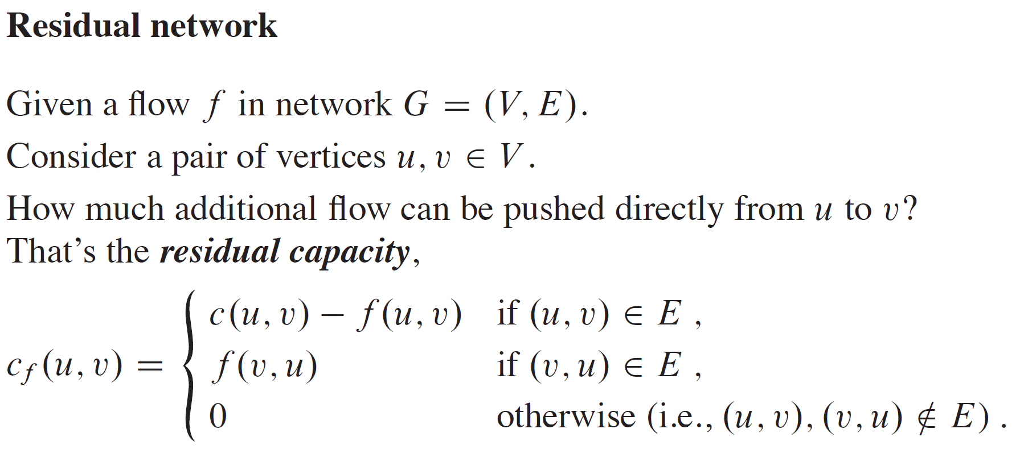
THE FORD-FULKERSON METHOD

Slide 9
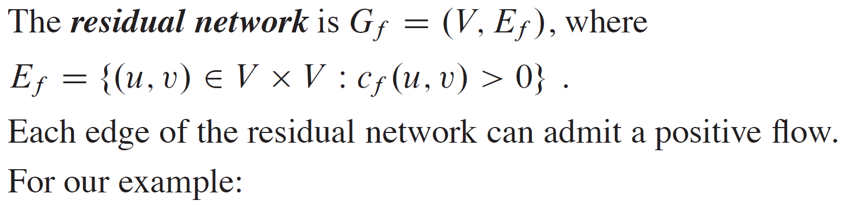
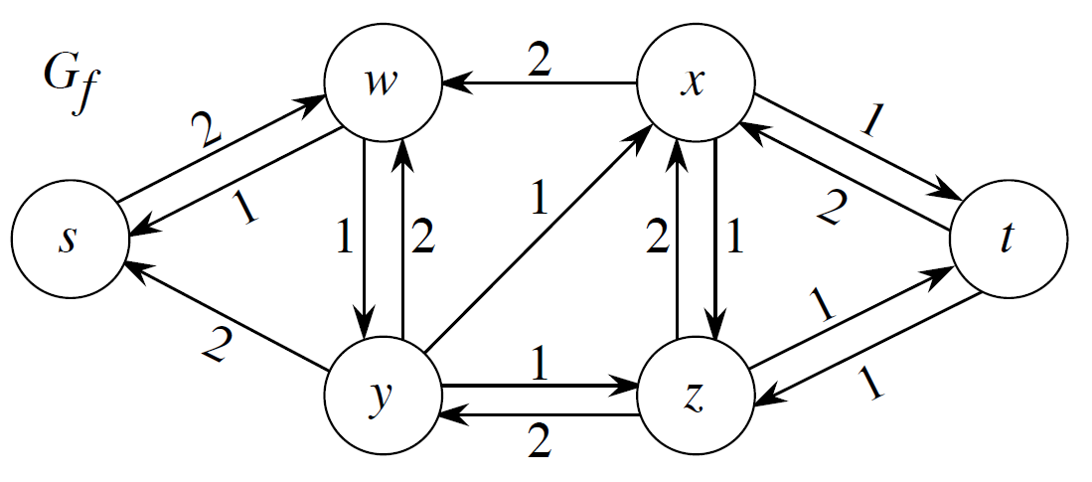
THE FORD-FULKERSON METHOD (continued)

Slide 10
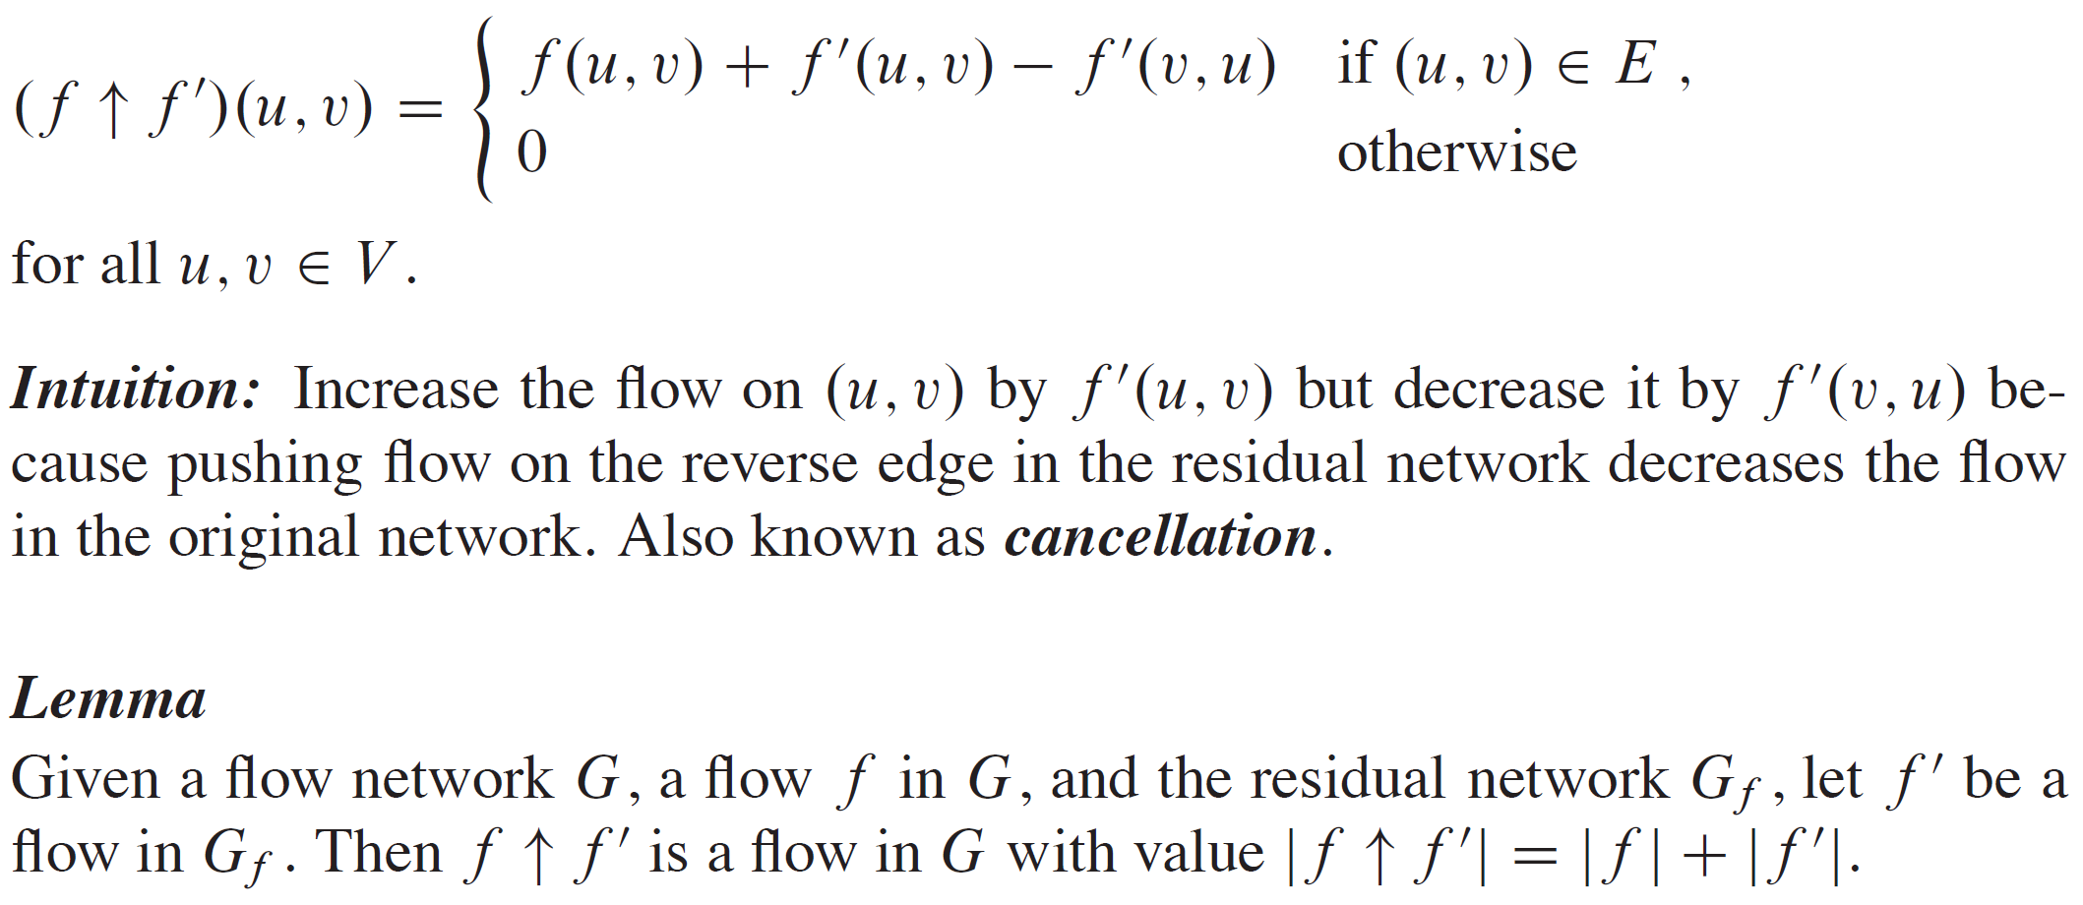
THE FORD-FULKERSON METHOD (continued)

Slide 11
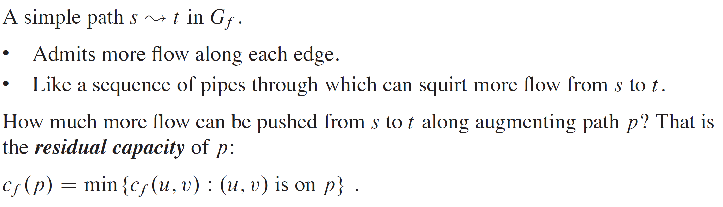
AUGMENTING PATH

Slide 12
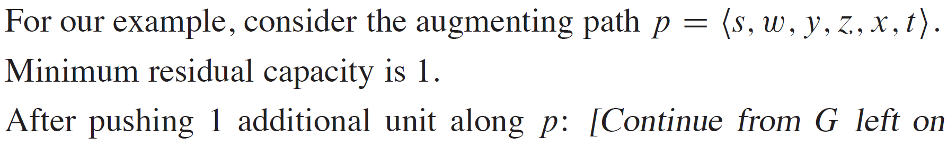
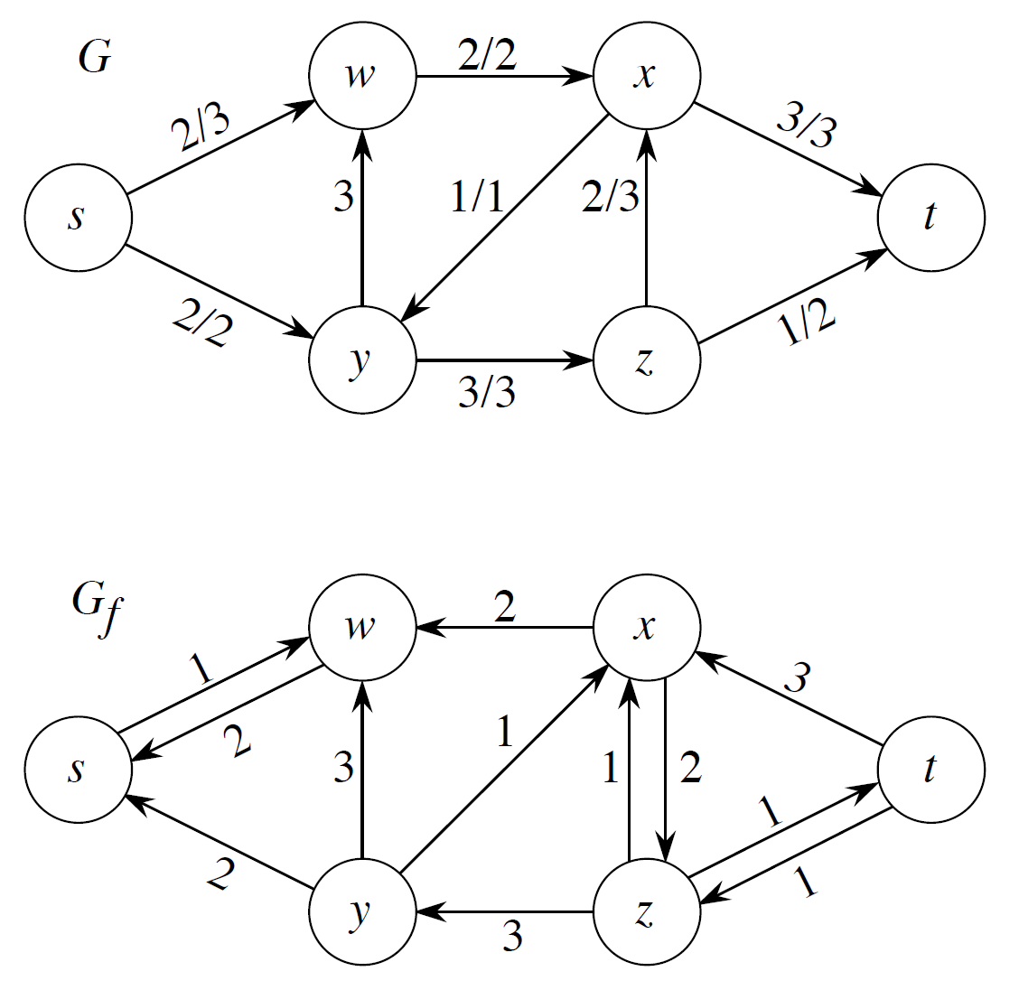
EXAMPLE
New Residual Network

Slide 13
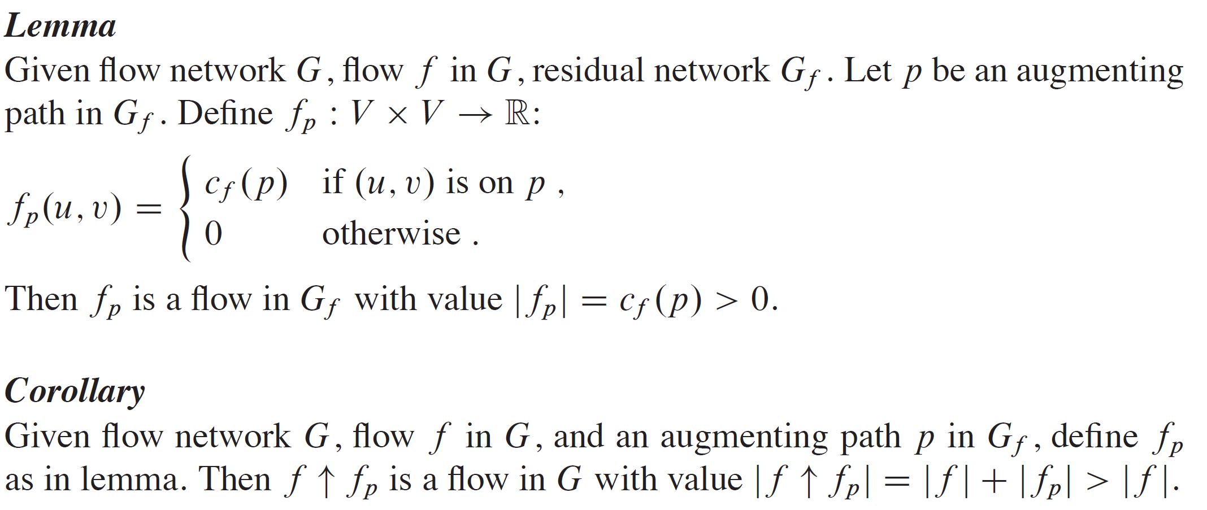
EXAMPLE (continued)

Slide 14
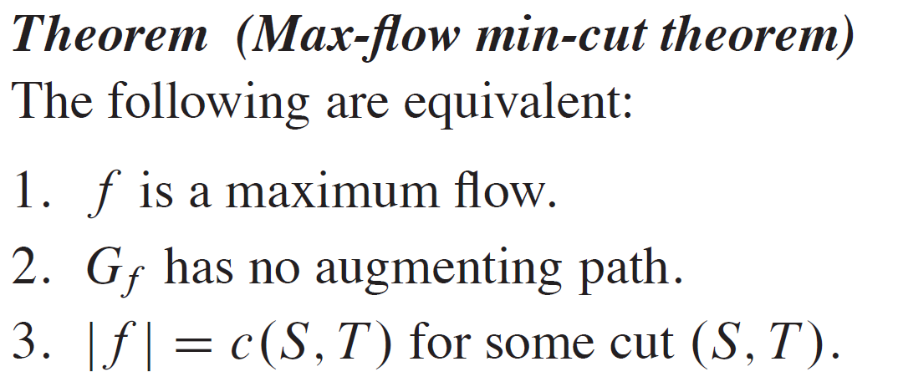
THEOREM

Slide 15
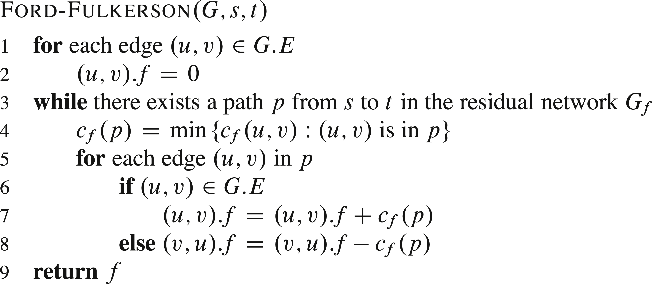
FORD-FULKERSON ALGORITHM

Slide 16
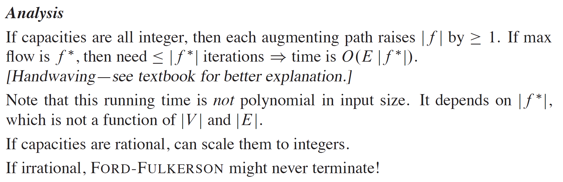
FORD-FULKERSON ALGORITHM (continued)

Slide 17
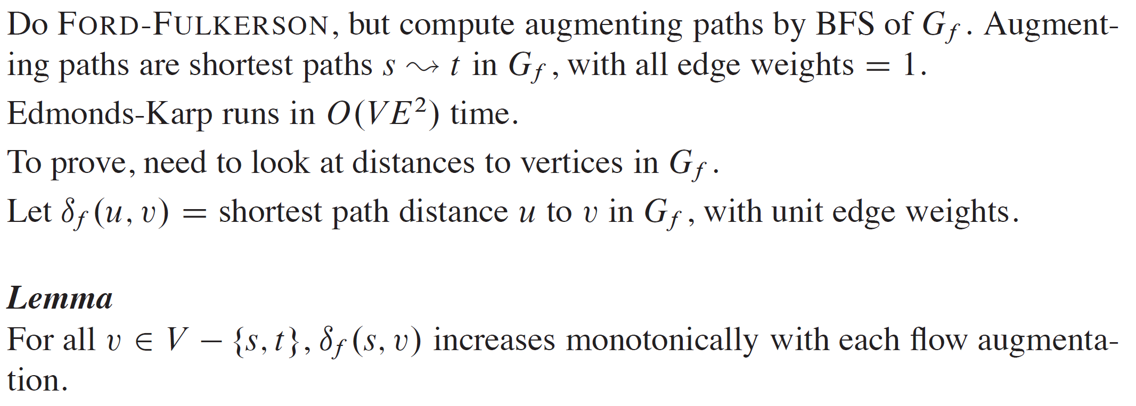
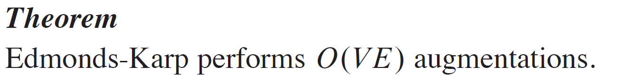
EDMONDS-KARP ALGORITHM

Slide 18
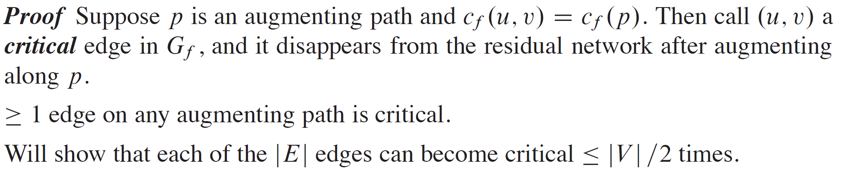
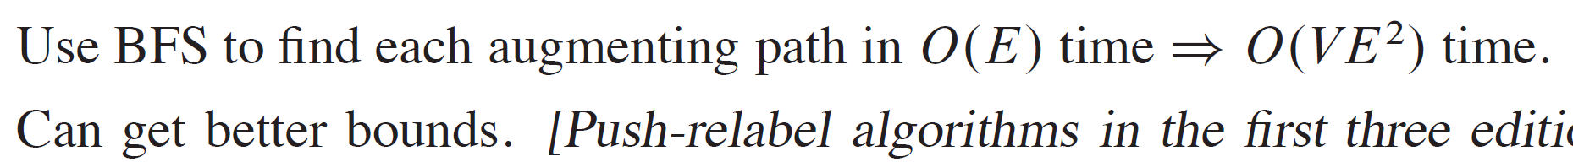
EDMONDS-KARP ALGORITHM (continued)

Slide 19
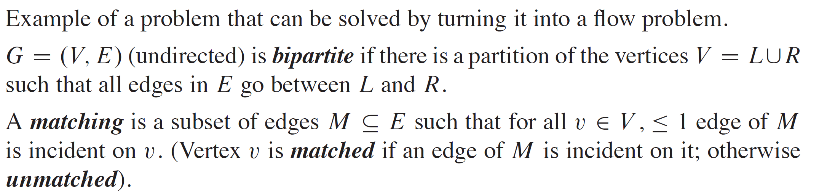
MAXIMUM BIPARTITE MATCHING

Slide 20
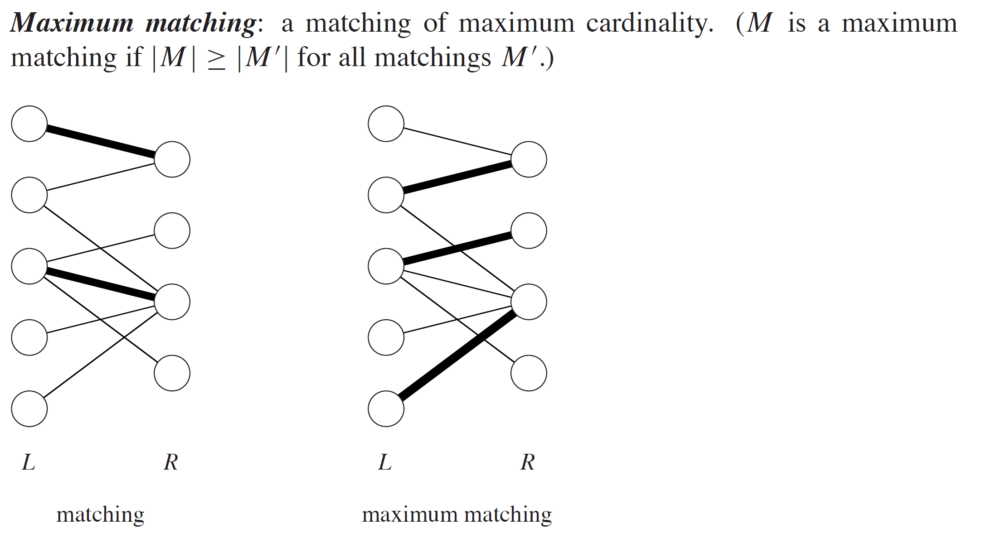
MAXIMUM BIPARTITE MATCHING (continued)

Slide 21
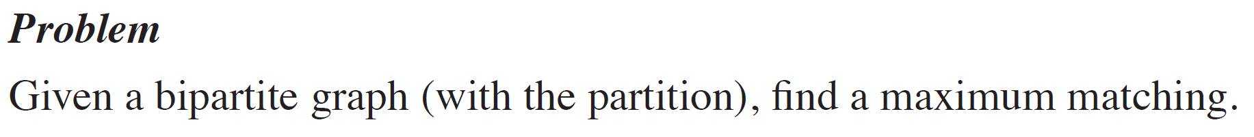
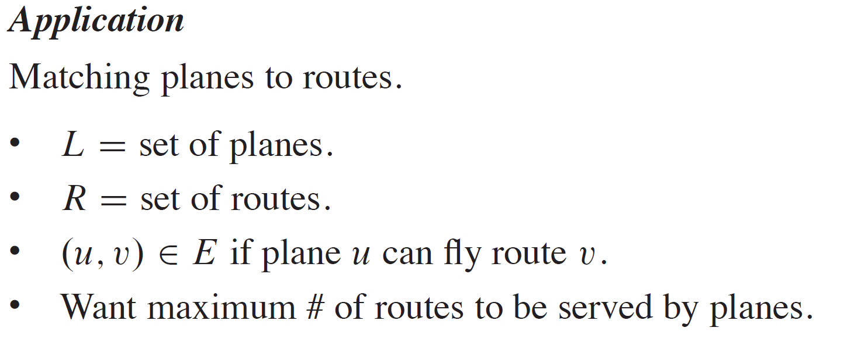
MAXIMUM BIPARTITE MATCHING (continued)

Slide 22
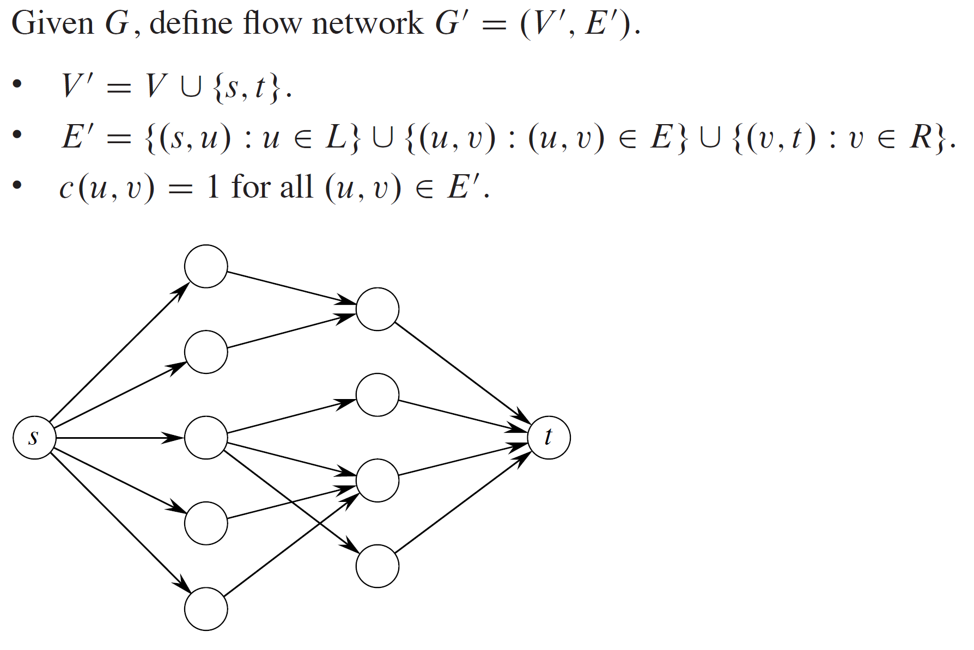
MAXIMUM BIPARTITE MATCHING (continued)

